Slide 1
Ethical Hacking Task 2 Finding Vulnerabilities in website using Netsparker Name-Kuldharan Sankalpa Rajendra

Slide 2
Screenshots of Netsparker along with vulnerabilities

Slide 3
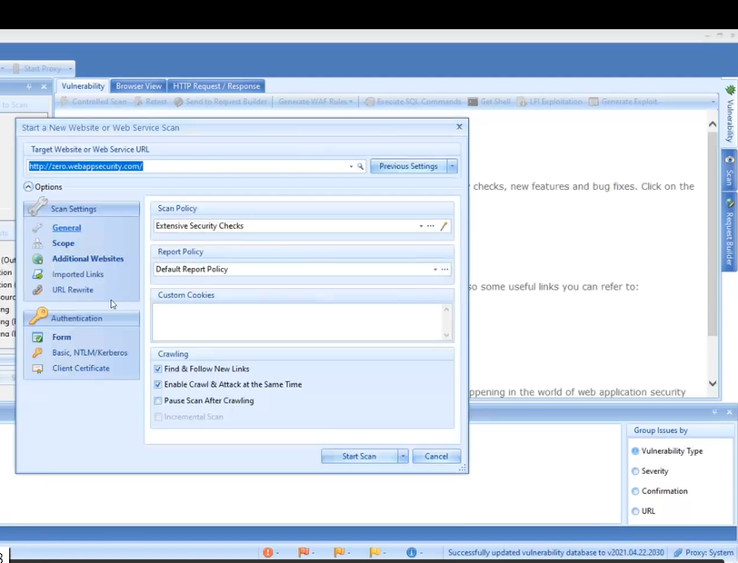

Slide 4
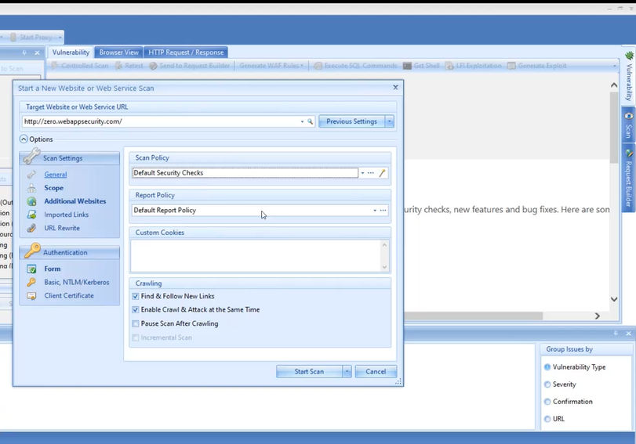

Slide 5
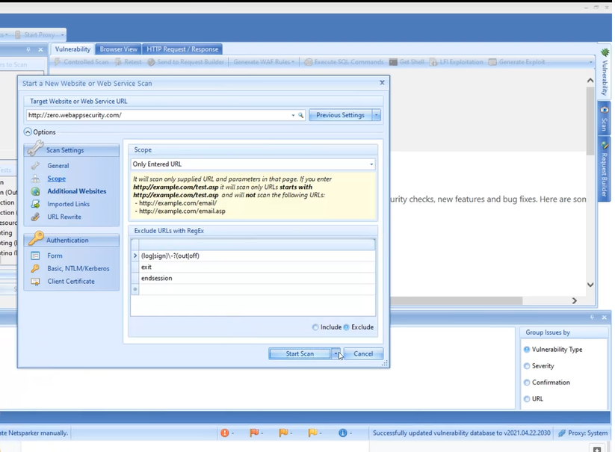

Slide 6
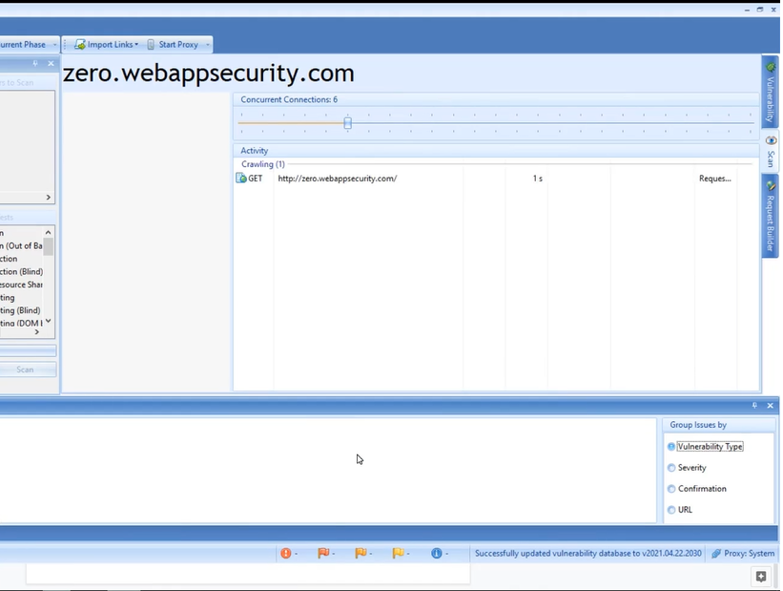

Slide 7
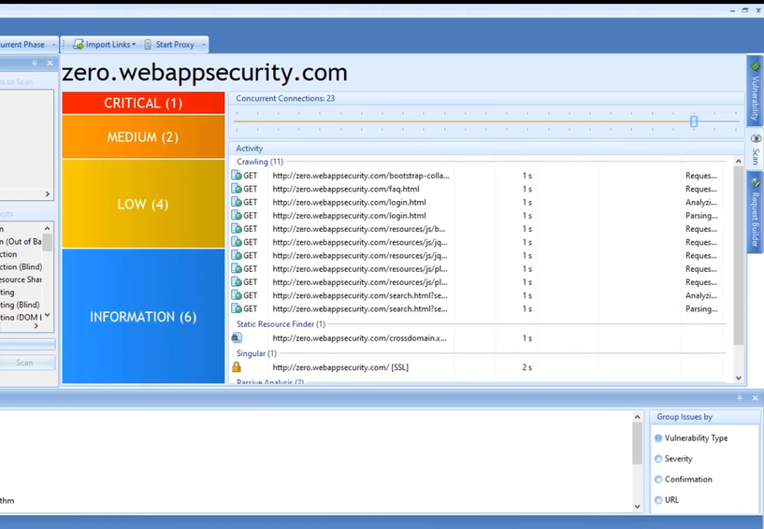

Slide 8
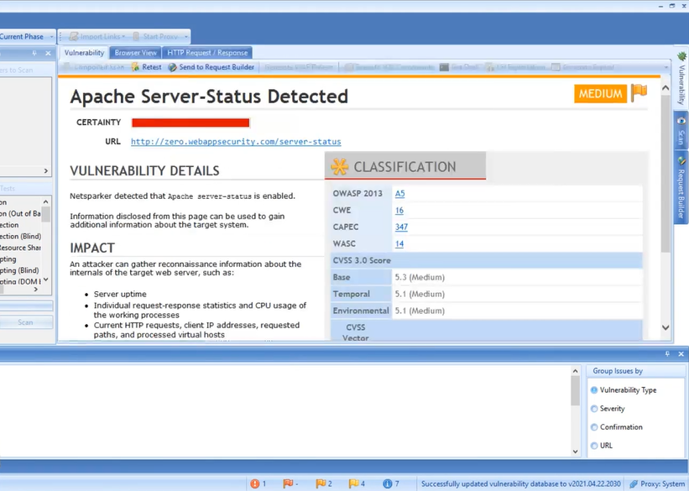

Slide 9
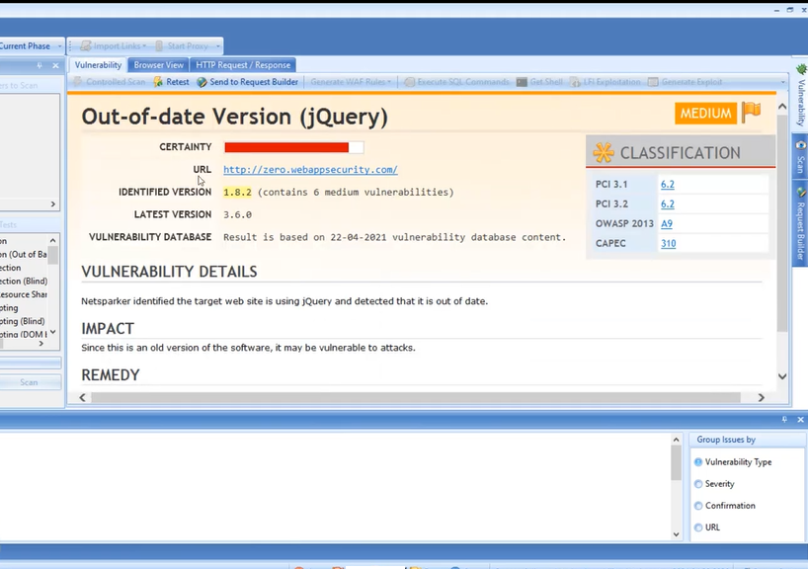

Slide 10
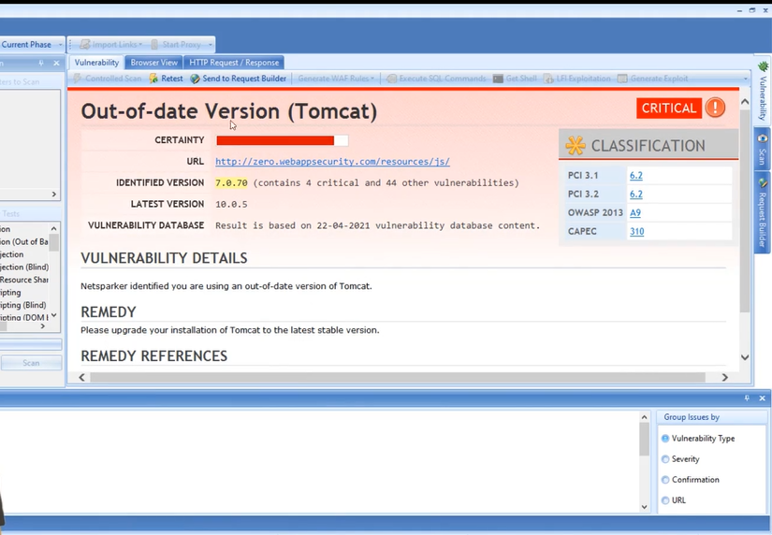

Slide 11
Report Written By Me of critical vulnerability

Slide 12
Report on vulnerabilty finding in http://zero.webappsecurity.com/ TITLE: Out-of-date version (Tomcat) DOMAIN: webappsecurity.com SUBDOMAIN: zero.webappsecurity.com Testing environment: Linux , Netsparker, Wifi Steps to reproduce: Step 1: Add Website you want to search (http://zero.webappsecurity.com/) to the dialogue box. Step 2: Define the customization option to scan as per your need Step 3: It will start scanning it automatically Vulnerability category: Critical Details of vulnerabilities: The version of Tomcat you are using is out of date identified during website scanning. Impact: It may reduce performance as well as speed of your website of bank. Mitigation : Please upgrade your Tomcat installation to the latest stable version. POC including screenshot/screen recording is including in the report which is attatched above.

